Slide 1
DIY Hexbeam
(or what I did during COVID)
Dave Palica
KR0OT
Notes:
Welcome
I would look at FT8 signal reports to see how my G5RV was working in comparison to others. Whenever I saw that I sent a great signal report, it was either a yagi, or a hexbeam.

Slide 2
A bit about me
Engineering manager for Brigham Young University Office of Information Technology
KD7TZG first licensed January 2003
Linux user since 2005
On the team that researched and brought enterprise Linux to Brigham Young University
ARRL Registered License Instructor
VE with W5YI-VEC and ARRL VEC
Vanity Call Sign KR0OT to merge love of radio and Linux
Notes:
Yes, I took Steve Whiteheads Saturday class.
Failed the first test
Passed the second time and received the call KD7TZG.
No radio for years. Tania got me one in 2019
General
Amateur Extra the same day my oldest son Andy got his Technician license - KJ7FUJ

Slide 3
A bit about you
What do you want to get out of this class?
This is an “open-source” training. I will do my best to address topics you are interested in and answer what questions you have.
Notes:
This course is my adventure in finding and building a better antenna to replace my G5RV multi-band antenna.

Slide 4
Why a Hexbeam?
Notes:
A Bit of History
The original HEX-BEAM was developed by Mike Traffie, N1HXA, in the early nineties. Mike says his design was inspired by the snowflake. He spent much time in testing and analysis of the antenna and developed the nesting concept that uses an inverted umbrella frame to allow multi band operation. Mike invented many of the unique fixtures and components that became a byword among HEX-BEAM owners and after much experimentation introduced the antenna commercially under the trademark, HEX-BEAM. It was reviewed in both CQ and QST magazines and soon earned a reputation for being a pileup buster among its owners. For a number of years it was the only commercially available hexagonal beam. Eventually, home brewers began building the “hex beam” and for years, web sites maintained by W1GQL and DL7IO were the intellectual source for those who wanted a classic “hex beam” but preferred to build it themselves. The Traffie beam is no longer offered commercially but there are a lot of Hexbeam aficionados and the beam was quite well made so it will be heard on the air for some time. Many homebrew versions of the original Hexbeam are in service today.
32
A Bit of History
The original HEX-BEAM was developed by Mike Traffie, N1HXA, in the early nineties. Mike says his design was inspired by the snowflake. He spent much time in testing and analysis of the antenna and developed the nesting concept that uses an inverted umbrella frame to allow multi band operation. Mike invented many of the unique fixtures and components that became a byword among HEX-BEAM owners and after much experimentation introduced the antenna commercially under the trademark, HEX-BEAM. It was reviewed in both CQ and QST magazines and soon earned a reputation for being a pileup buster among its owners. For a number of years it was the only commercially available hexagonal beam. Eventually, home brewers began building the “hex beam” and for years, web sites maintained by W1GQL and DL7IO were the intellectual source for those who wanted a classic “hex beam” but preferred to build it themselves. The Traffie beam is no longer offered commercially but there are a lot of Hexbeam aficionados and the beam was quite well made so it will be heard on the air for some time. Many homebrew versions of the original Hexbeam are in service today.

Slide 5
Why a Hexbeam?
- Gain
Front/Back comparable to a two element full size Yagi
Notes:
I get 3-6 db gain or about ½ to 1 full S unit of gain
Receive is much quieter than my dipole
32

Slide 6
Why a Hexbeam?
- Gain
Front/Back comparable to a two element full size Yagi
- Bands
Six bands with low SWR without a tuner
Additional bands with a tuner
Notes:
Six Bands:
6 M
10 M
12 M
15 M
17 M
20 M
With tuner (MFJ 939i) I also get:
40 M
60 M
80 M
Not Tunable:
160 M will not tune up on this antenna
32

Slide 7
Why a Hexbeam?
- Gain
Front/Back comparable to a two element full size Yagi
- Bands
Six bands with low SWR without a tuner
Additional bands with a tuner
- Broadband characteristics
Low SWR across all bands
Notes:
I get less than 1 : 1.2 SWR across the tuned bands.
32

Slide 8
Why a Hexbeam?
- Gain
Front/Back comparable to a two element full size Yagi
- Bands
Six bands with low SWR without a tuner
Additional bands with a tuner
- Broadband characteristics
Low SWR across all bands
- Low weight and low wind load
Can use more economical support structures
Notes:
32

Slide 9
Why a Hexbeam?
- Gain
Front/Back comparable to a two element full size Yagi
- Bands
Six bands with low SWR without a tuner
Additional bands with a tuner
- Broadband characteristics
Low SWR across all bands
- Low weight and low wind load
Can use more economical support structures
- Construction from general hardware components
Notes:
Load area is about 5 square feet. Will easily survive 70MPH and more winds. Great for being at the mouth of Spanish Fork Canyon.
32

Slide 10
Why a Hexbeam?
- Gain
Front/Back comparable to a two element full size Yagi
- Bands
Six bands with low SWR without a tuner
Additional bands with a tuner
- Broadband characteristics
Low SWR across all bands
- Low weight and low wind load
Can use more economical support structures
- Construction from general hardware components
- Ease of adjustment
Most adjustments with a screwdriver
Notes:
32

Slide 11
Cost?
Commercial Options:
MFJ-1846 $600.00
KIO Technology $516.00 (20 meters only) Additional bands are $61.00 each
K4HEX $660.00
Etc.
OR
DIY for about half the cost.
https://hex-beam.com contains all of the details and is what I used to build my hex-beam antenna.
Notes:
32

Slide 12
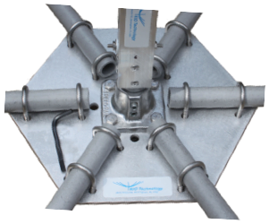
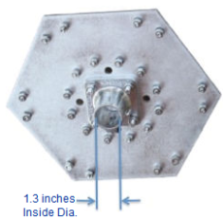
Major Components:
Base Plate
Notes:
32

Slide 13
Major Components:
Base Plate
Spreader Arms
Center Post
Wire Sets
Support Cords
I HIGHLY recommend you order a set of fiberglass spreader arms. I ordered mine as a kit from https://mgs4u.com/hexbeam-antenna-parts/. Cost is $150 for grey, $200 for black. Note, you will need to paint them with a UV resistant paint because over time, fiberglass will become brittle and flake/split/break when exposed to sunlight.
Notes:
32

Slide 14
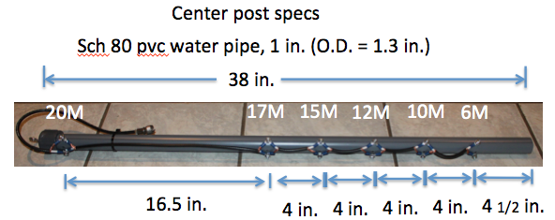
Major Components:
Base Plate
Spreader Arms
Center Post
Wire Sets
Support Cords
Notes:
Gotcha! Make sure to drill the holes far enough apart that the screw posts don’t touch on the inside of the tube.
32

Slide 15
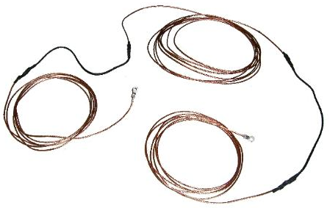
Major Components:
Base Plate
Spreader Arms
Center Post
Wire Sets
Support Cords
Notes:
Make sure that you measure accurately! Your SWR meter will thank you!
32

Slide 16
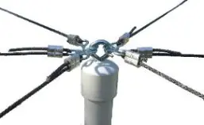
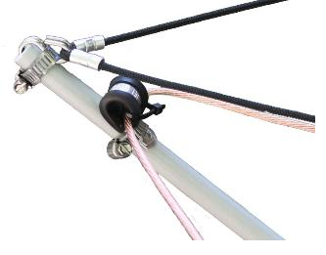
Major Components:
Base Plate
Spreader Arms
Center Post
Wire Sets
Support Cords
Notes:
32

Slide 17
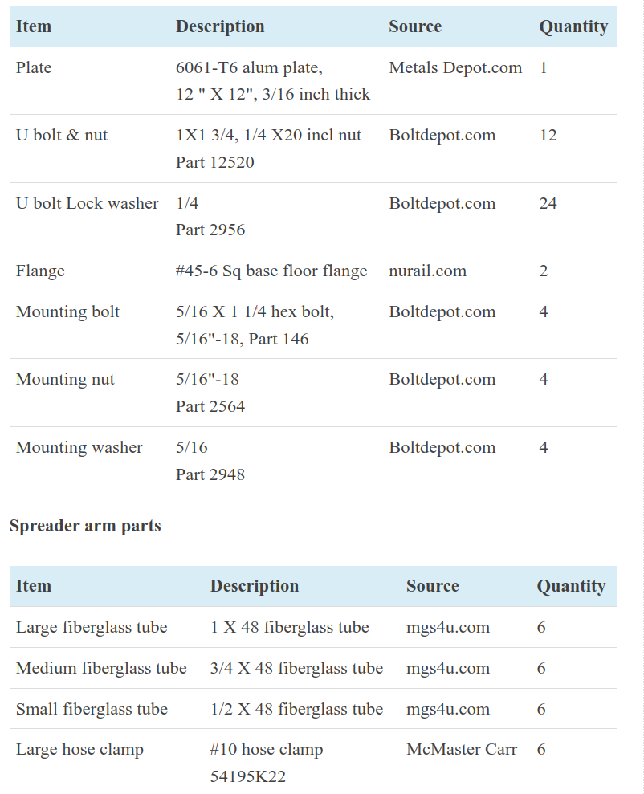
Parts:
A full list of needed parts and sources is located at
https://hex-beam.com/parts
Stainless Steel is recommended, but more expensive. Zinc coated is less expensive. Either will work well. I chose stainless and was around $300 for the entire antenna.
This list is a great starting point to source parts.
I shopped around and got some parts cheaper.
Notes:
32

Slide 18
Assembly:
It doesn’t matter what order you assemble the components. I built this over a few months to spread out the cost. The availability of parts was a bit spotty, but I only had to wait a few days to a few weeks to get the parts that I needed.
Once the components are all complete, then it is a good idea to assemble the antenna on a large table or a post. I put a 5’ section of chain link top-rail in a bucket of cement and to assemble the antenna. A 6’ step-ladder was needed to reach the 17 and 20 meter bands.
Notes:
32

Slide 19
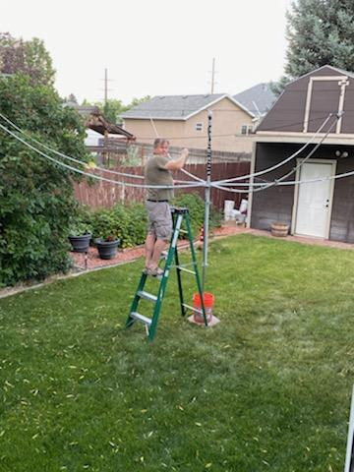
Tuning:
I use a RigExpert tuner for my
tuning needs. I was able to get the
SWR close to 1:1. The bandwidth
is really good and receive is really
quiet on this antenna.
First contact was on June 25, 2022
20 M. Lynn Young - K7HAM
from Gilbert AZ on FT8.
Notes:
32

Slide 20
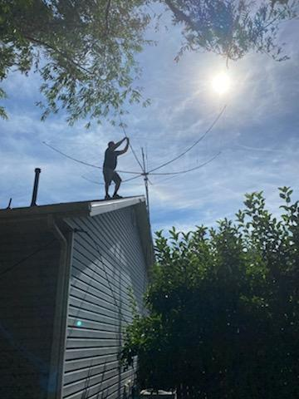
Installing:
The Hexbeam weighs about 25 lbs. This is a bit heavy for a fiberglass mast so I ordered a 35’ telescoping steel mast from ROHN. I carried the hexbeam up on the roof like an umbrella and used two u-bolts to fasten it to the mast. The bottom of the hexbeam is a 1.25 OD 4’ fiberglass mast from the spreader arm kit. This worked well until….
Notes:
32

Slide 21
Installing:
I inherited a Yaesu G-400RC antenna rotator from Ken Krutsch KM7TJ. I put in the rotator and with the Spanish Fork Canyon wind and ...
Notes:
32

Slide 22
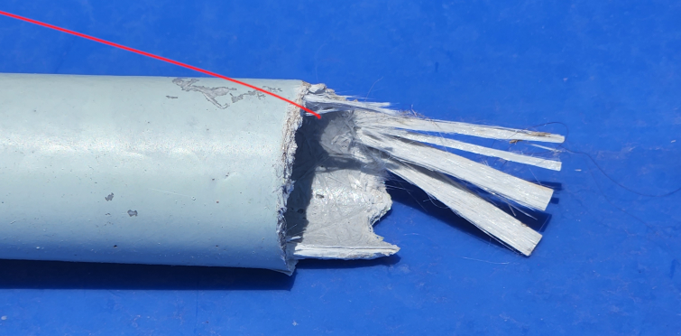
Installing:
SNAP! Three days later we had gusting winds. The 4’ fiberglass was too flexible and broke. I replaced it by putting a shorter section of chain-link top rail.
It holds up to the wind MUCH
better.
Notes:
32

Slide 23
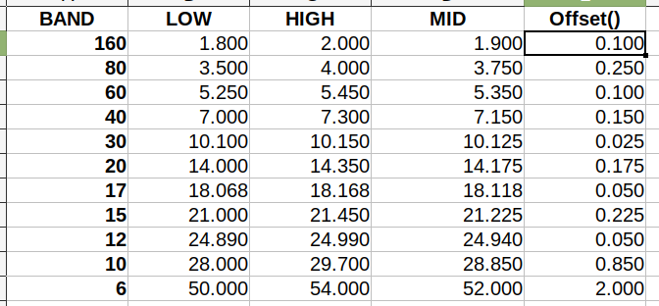
Results:
Notes:
These are the bands from the ARRL Chart. MID is the middle of the band. The offset is the +- offset from the middle of the band to the edges.
32

Slide 24
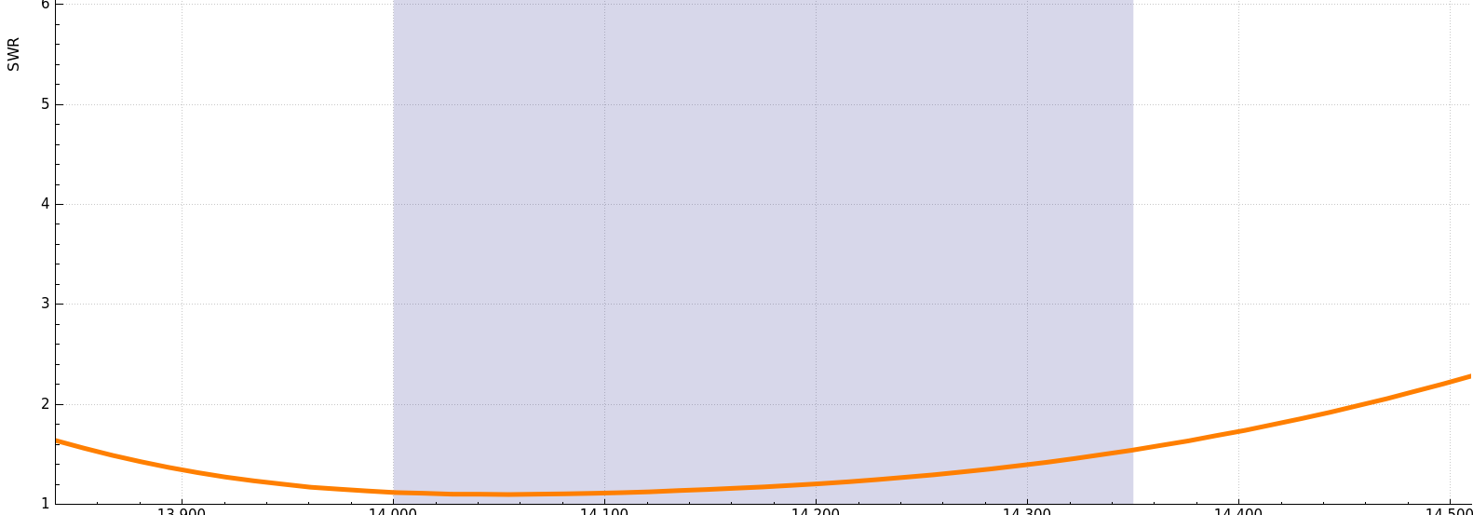
20M:
Notes:
32

Slide 25
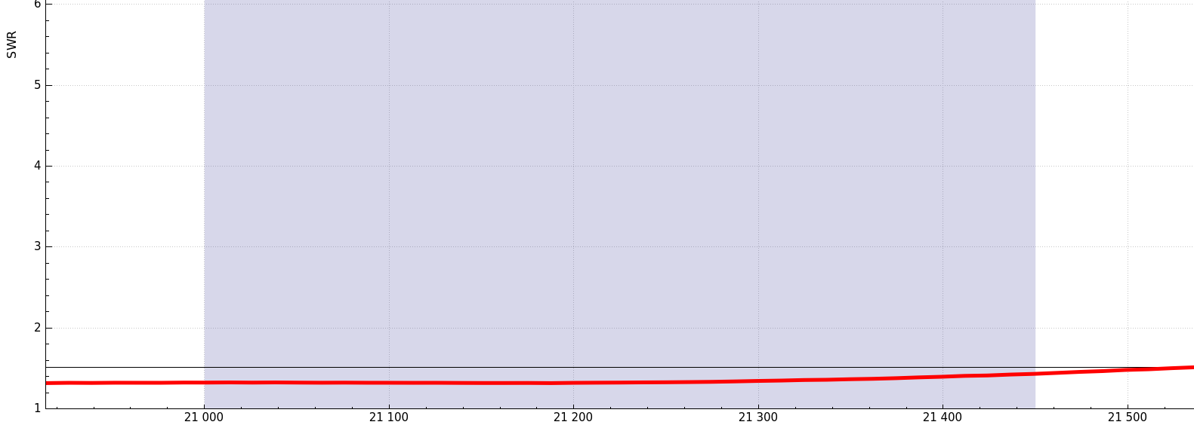
17M:
Notes:
32

Slide 26
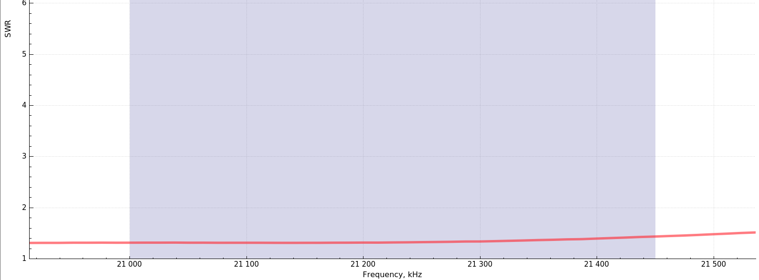
15M:
Notes:
32

Slide 27
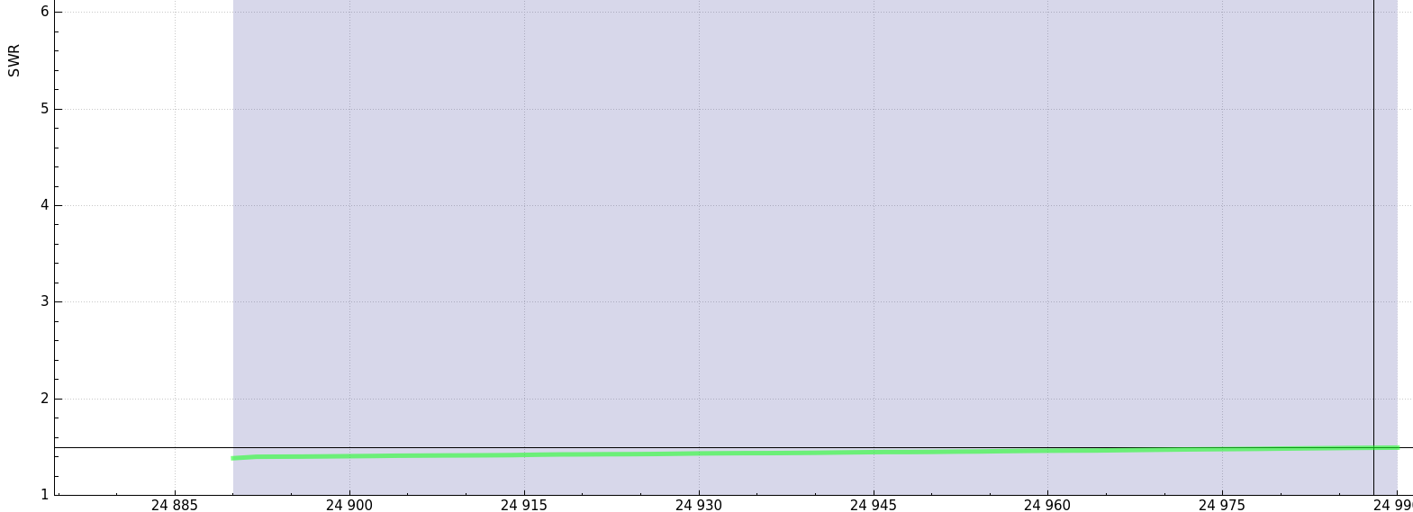
12M:
Notes:
32

Slide 28
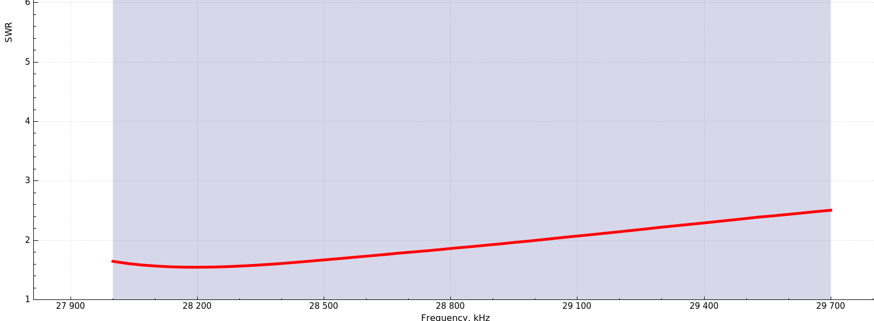
10M:
Notes:
32

Slide 29
But what about the other bands?
Notes:
32

Slide 30
But what about the other bands?
I also get 40M, 60M, and 80M. 160M is > 1:10 so my tuner won’t tune this band up.
Notes:
32

Slide 31
Special Thanks to:
Mike Traffic N1HXA for inventing the Hex Beam
Se Hunt G3TXQ (silent key) and Leo Shoemaker, Jr. K4KIO for the DIY Hexbeam web page.
Ken Krutch KM7TJ for donating a rotator to this project.
Courtney Elliot KJ7DNK neighbor and fishing buddy of almost 30 years for his generous offers to help
And of course my XYL Tania for her encouragement for yet another antenna.
Notes:
32

Slide 32
Questions?
Notes:
<number>

Slide 33
How to contact me
KR0OT@byu.edu
UVARC Slack
And if you hear me on the radio!

Slide 34
Additional Resources
Or how to WINLINK like a Ninja
https://winlink.org/
https://www.youtube.com/results?search_query=winlink
K4REF videos are especially useful.
http://www.w1hkj.com/
W1HKJ & Associates – Makers of FLRIG, FLDIGI, etc.
Notes:
1. https://winlink.org
2. Andy Stewart KB1OIQ has a linux (Ubuntu based) live image you can download (Last updated 10/21)
3. DX Zone has a pretty comprehensive list of software for linux.
4. Youtube has many good videos on WINLINK, especially K4REF

